Slide 1

ENHANCING STOCK PRICE PREDICTION WITH LSTM AND RNN

Slide 2
Team working on this
I
CHAITANYA ALLURI -DATA SCIENTIST
RENUKA GADDE DATA ENIGINEER
SAITEJA RESEARCH ENIGINEER
SANTHOSH CLOUD ARCHITECT

Slide 3
The Problem
Problem #1 Inaccurate Predictions
---Stock price prediction models often struggle to accurately predict future market movements due to their inability to accurately capture complex market dynamics, resulting in unreliable predictions and potential financial losses.
Problem#2
Lack of Timeliness
--Existing prediction models often rely on outdated data or lack real-time stock price insights, limiting investors' ability to make informed decisions in fast-paced markets.
Problem #3
Limited Model Flexibility
--Traditional stock price prediction models may not adapt to market changes or incorporate new information, potentially leading to missed opportunities and increased investor risk. .

Slide 4
The Solution
Explain the solution that your product / service will provide
Solution #1 --Utilize advanced deep learning techniques like LSTM and RNN to capture complex patterns in sequential data, and apply sophisticated feature engineering methods to extract relevant information from historical stock price data.
Solution #2 --Create a real-time stock price prediction system using streaming data and cloud-based infrastructure, ensuring timely insights and automated alerts for market events.
Solution #3 --LSTM and RNN models with flexible architectures, transfer learning techniques, and customizable parameters ensure relevance and accuracy, while providing users with personalized investment strategies.

Slide 5
Bussiness Model
Objective: Enhancing stock price prediction using LSTM and RNN to improve investment decisions. Aim to provide more accurate and actionable predictions for investors and financial professionals. Ultimately, mitigate risks and achieve higher returns on investments.
Activities:
In today's fast-paced financial markets, accurate prediction of stock prices is critical for investors, traders, and financial institutions to make informed decisions and maximize returns on investments. .
Traditional methods of stock price prediction often fall short in capturing the complex patterns and dynamics inherent in financial time series data. Therefore, there is a compelling industry challenge to develop more robust and accurate prediction models.
By leveraging advanced deep learning techniques such as Long Short-Term Memory (LSTM) and Recurrent Neural Networks (RNN), our project aims to address this challenge by enhancing the accuracy and reliability of stock price prediction. These techniques are well-suited for capturing temporal dependencies and patterns in sequential data, making them ideal for modeling the dynamics of stock price movements.
The business objective is to provide investors and financial professionals with a powerful tool that can generate more accurate and actionable predictions of stock prices. This will enable them to make better-informed investment decisions, mitigate risks, and ultimately, achieve higher returns on their investments.

Slide 6
Modeling
Activities:
Design LSTM and RNN architectures to capture temporal dependencies and patterns in stock price data. Define input layers to receive sequential data and output layers to generate predictions. Configure LSTM and RNN layers with appropriate parameters such as number of units, activation functions, and dropout rates. Compile the model with suitable loss functions, optimizers, and evaluation metrics for training. Train the model on historical stock price data and evaluate its performance using validation datasets.

Slide 7
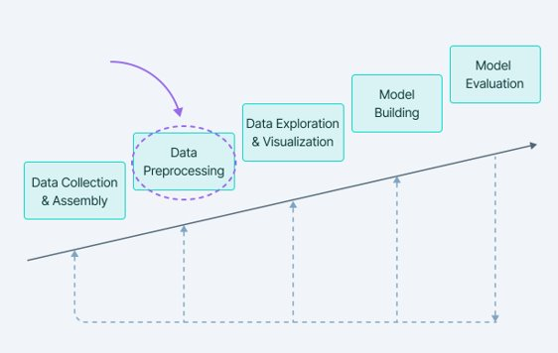
Methodology

Slide 8
EVALUATION​
Evaluation for Enhancing Stock Price Prediction with LSTM and RNN
Conduct sensitivity analysis by adjusting hyperparameters and observing changes in model performance. Assess the model's robustness by testing it on unseen data or during periods of market volatility to ensure its generalization capability.
Compare the predicted prices with actual prices to determine the model's reliability and effectiveness in real-world scenarios.
Analyzing the model's ability to capture trends, patterns, and fluctuations in stock prices over different time periods.
Calculating performance metrics such as Mean Absolute Error (MAE) and Root Mean Squared Error (RMSE) to assess the accuracy of the predictions..

Slide 9
Deployment
Plan
Develop a user-friendly web application or API endpoint to provide access to the trained model..
Implement
Implement a front-end interface for users to input historical stock price data and receive real-time predictions.
Monitor
Host the application on a scalable cloud platform such as AWS or Google Cloud to ensure reliability and availability..
Integrate
Integrate the model into existing trading platforms or financial software for seamless integration into workflow processes.Continuously monitor model performance and update the deployment as needed to adapt to changing market conditions or improve prediction accuracy.

